Slide 1


Gurdeep Singh
Rapido
Overview
Review
July 2025 Performance | Building India’s Ride
Network

Slide 2

THE STORY IN NUMBERS
30,000 Rides Requested
₹ 34.5 Lakh Revenue Generated
82% Success Rate
24,641 Trips Completed

Slide 3



KEY FINDINGS
01

Slide 4

KEY FINDINGS
CANCELLATION RATE AROUND 12%

Slide 5

KEY FINDINGS
FREQUENT USERS CONTRIBUTE ~40% OF TOTAL RIDES

Slide 6
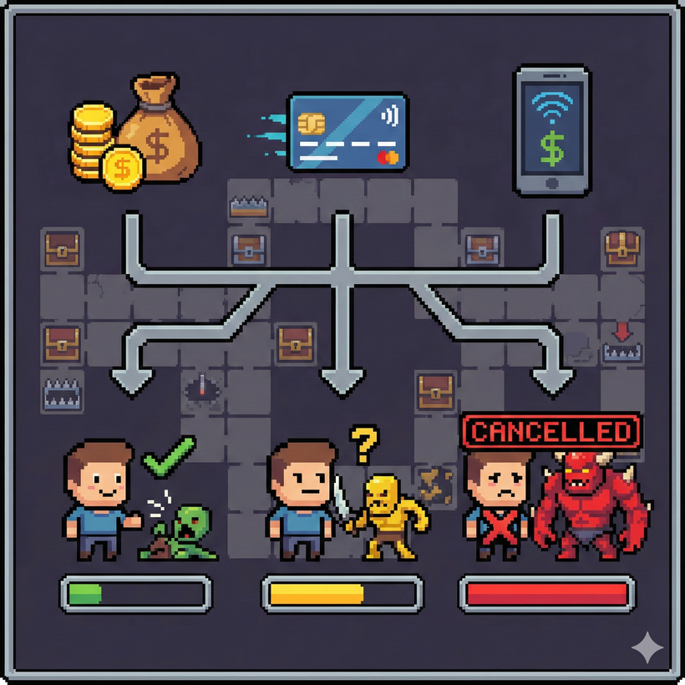
KEY FINDINGS
Payment method influences cancellation likelihood

Slide 7

KEY FINDINGS
Peak demand hours: 9AM and 6PM

Slide 8

KEY FINDINGS
Incomplete rides driven by network issues and driver delays

Slide 9

RECOMMENDATIONS
02

Slide 10

RECOMMENDATIONS
Improve riders incentives in peak hours

Slide 11

RECOMMENDATIONS
Prioritize quality of service for loyal recurring customers.

Slide 12
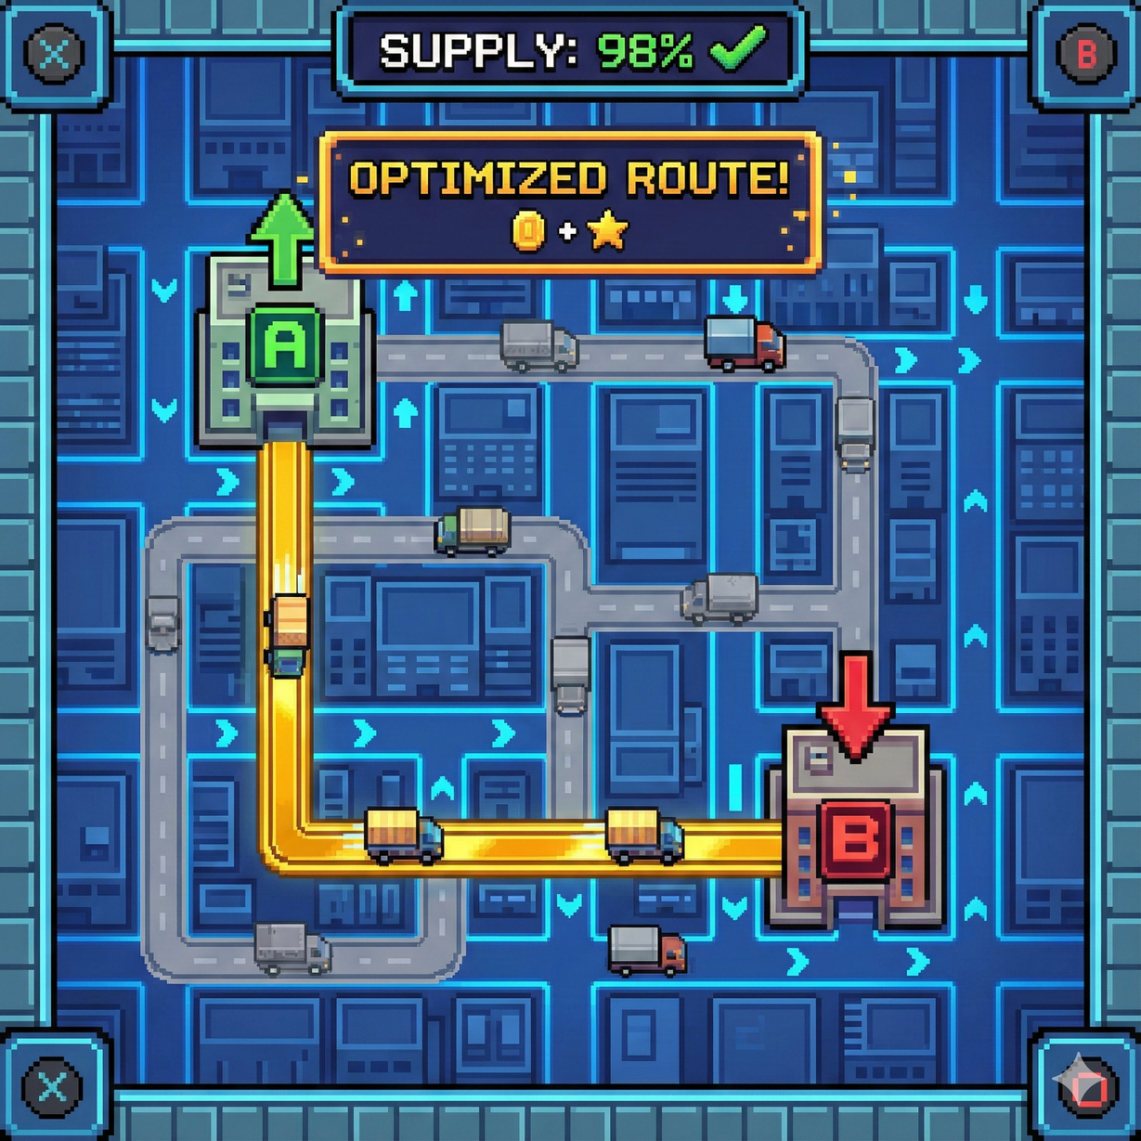
RECOMMENDATIONS
Optimize supply in top pickup drop corridors.

Slide 13

RECOMMENDATIONS
Strengthen app stability to reduce incomplete rides.

Slide 14

RECOMMENDATIONS
Push digital payments using targeted offers.

Slide 15

Conclusions
This analysis shows that improving reliability and customer experience can meaningfully increase Rapido’s ride completion and overall performance. Cancellations remain the biggest challenge, especially during peak hours, and are influenced by payment preferences and operational delays.
Loyal users drive a large share of rides, highlighting the value of retaining and rewarding them. By strengthening driver support, improving app stability, and optimising supply during high-demand periods, Rapido can deliver smoother rides, reduce drops, and create a more trusted experience for both customers and drivers.

Slide 16

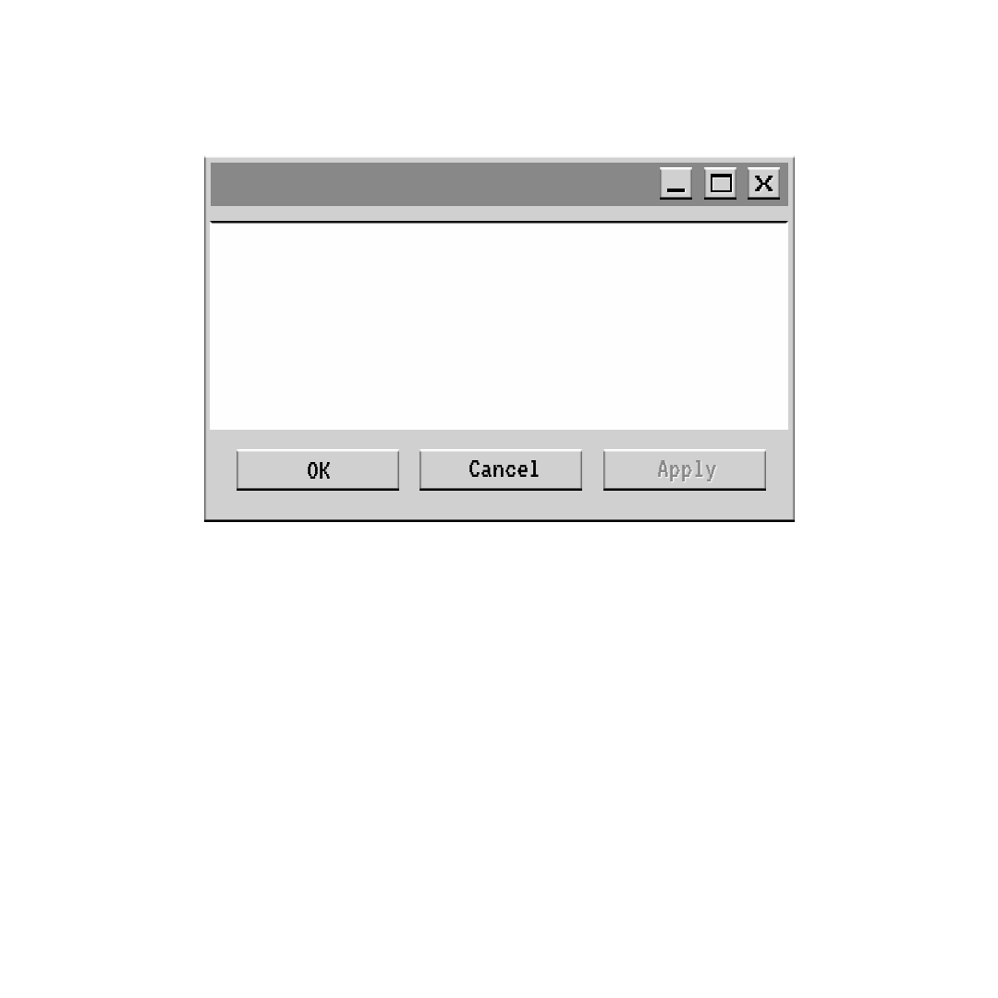


Thank you
Do you have any questions?
Gurdeep Singh
+91 9557846089
think
DIFFERENT.

